Slide 1

LET’S MAKE LEARNING SIMPLE AND COOL
Team leader： 阙兮瑶
Team member 李梦迪
吕梦琪
叶琳琳
周梦伊
董金
戴佳

Slide 2


WHAT RAILS IS
Ruby on Rails is an open-source web framework that’s optimized for programmer happiness and sustainable productivity.
Ruby on Rails emphasizes the use of well-known software engineering patterns and principles, such as convention over configuration, don't repeat yourself.

Slide 3
WHAT RAILS DOES
Model-View-Controller
Model:ActiveRecord achieve the object-relational mapping system for database access.
View:ActiveView display a user interface according to the data in the model.
Controller:ActiveController responds to external requests from the web server to the application by determining which view file to render.

Slide 4
EXAMPLE
Database
Online tutor
FAYE
Faye is a publish-subscribe messaging system based on the Bayeux protocol. It provides message servers for Node.js and Ruby, and clients for use on the server and in all major web browsers.
Client

Slide 5
CLASS DIAGRAM

Slide 8
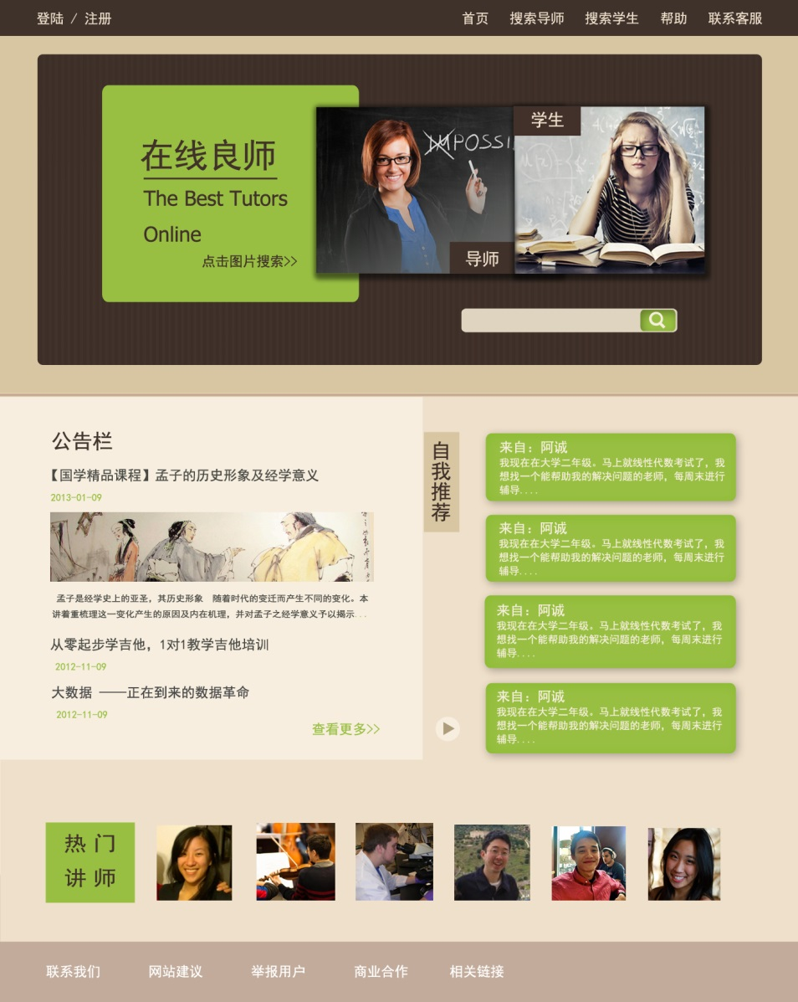
HOME
Navigation bar
Notice board
Self recommendation
Hot tutor

Slide 9
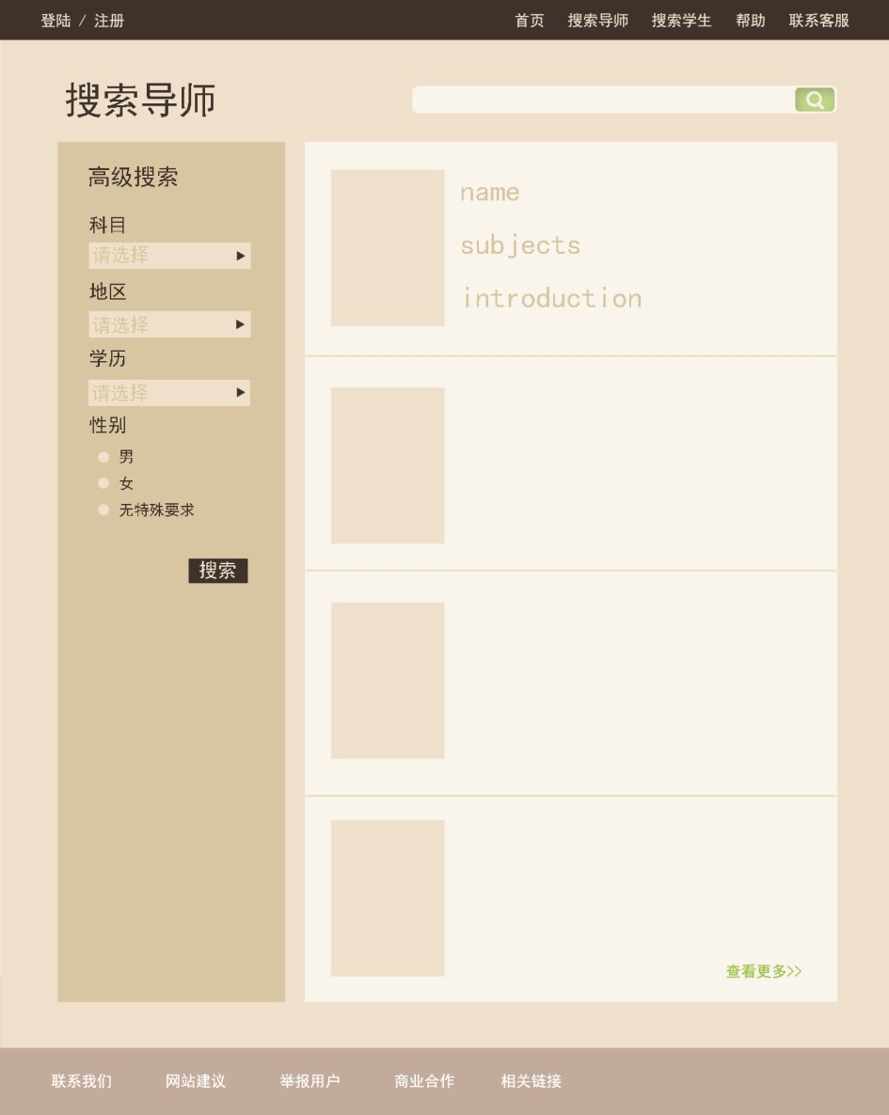
SEARCH PAGE
Keyword search
Advanced search
Tutor list

Slide 10
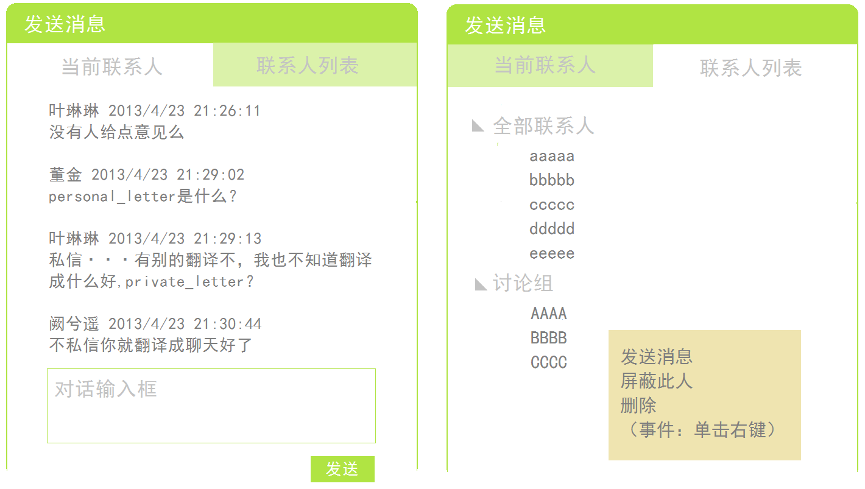
MESSAGE PAGE

Slide 11
THANKS FOR COMING
SEE YOU SOON!

